Slide 1
Inference
Reasoning Through Evidence
6th Grade

Slide 2
Infer
to draw a conclusion, as by reasoning.
to guess; speculate; surmise.
to conclude or judge from evidence:

Slide 3
The policeman held up his hand and stopped the car.
Did the policeman touch the car?
Did the driver step on the brakes?

Slide 4
What is going on in each picture?
Make an inference for each picture.
I can infer that…..

Slide 6
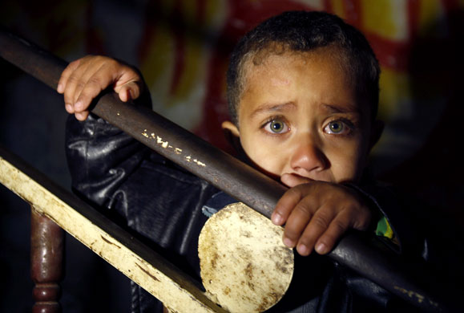

Slide 9
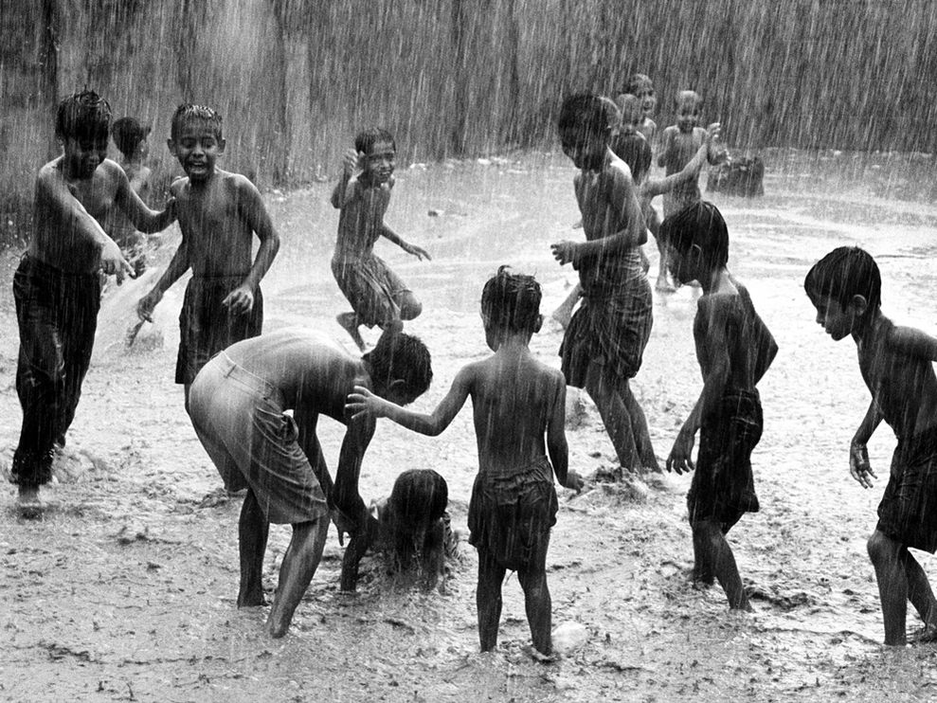

Slide 10
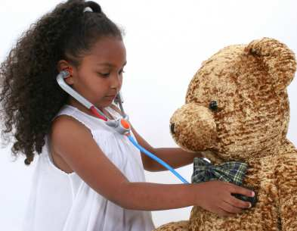

Slide 11
Let’s practice!
What can you infer from these short passages?

Slide 12
Shanay had never seen so many fish before. She looked around at the huge tanks and could see hundreds of fish, crabs, shrimp, and all other amazing creatures completely surrounding her. She never thought she could feel like she was completely underwater, yet still be completely dry.
Where is Shanay?
underwater in the ocean
What is she doing? How could you tell?
Scuba diving, she is looking at the huge tanks, she is dry
Why is she dry?
She is wearing a scuba diving suit.

Slide 13
Mother told me I needed to stop, but I couldn’t stop now, not when I was so close to winning. My eyes were fixated on the television and the controller was in my hand. I didn’t even see my mother when she walked into the room.
What is the boy doing?
Playing video games
* He has a controller in his hands.
How do you know? Give details to support your inference.
* He is close to winning.
* His eyes are on the television.

Slide 14
Now try it on your own!

